Slide 1
Car License Plate Detection and Recognition in MATLAB
A Comprehensive Approach to Automated License Plate Recognition
Abed El Rahman Mneimneh – Omar Al Taki

Slide 2
Problem Statement: License plate recognition is critical for traffic management, toll systems, and security.
Solution: MATLAB-based software to detect and read license plates from images.
Key Features:
User-friendly image selection.
Morphology-based plate localization.
Custom template-matching OCR.

Slide 3
Workflow Overview
Image Input
Preprocessing
Plate Localization
OCR
Result Annotation

Slide 4
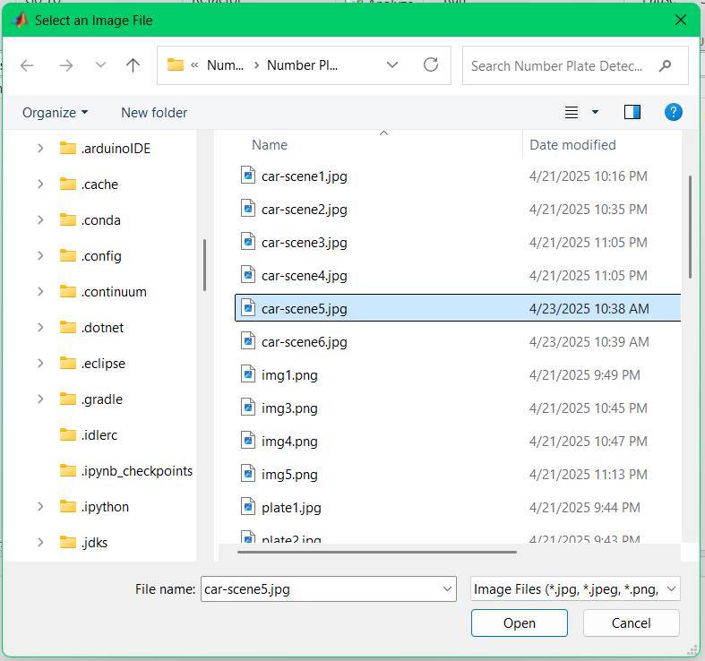
Image Input & Preprocessing
Grayscale conversion
Contrast enhancement (adapthisteq)
Noise reduction (imgaussfilt)

Slide 5
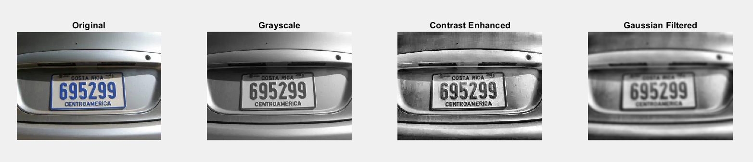
Preprocessing

Slide 6
Plate Localization
Key Techniques:
Edge Detection: vertical edges detection using edge() with ‘Sobel’.
Morphological Operations:
Thickening vertical edges using imdilate().
Filling gaps using imclose().
Area filtering using bwareopen().
Aspect Ratio Filtering: Retain regions with ratio 2:1 to 6:1.
Why It Works:
License plates have dense vertical edges and standardized proportions.

Slide 7
OCR Process
Clean the image
Crop plate region
Enhance Contrast
Binarize
Invert
Clear borders
Filter Small Things
Segment characters using regionprops.
Match characters to pre-loaded templates.

Slide 8
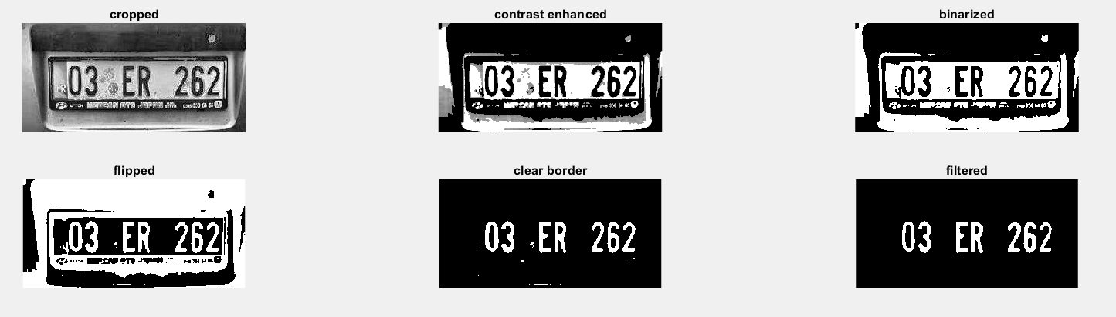
Cleaning The Image

Slide 9
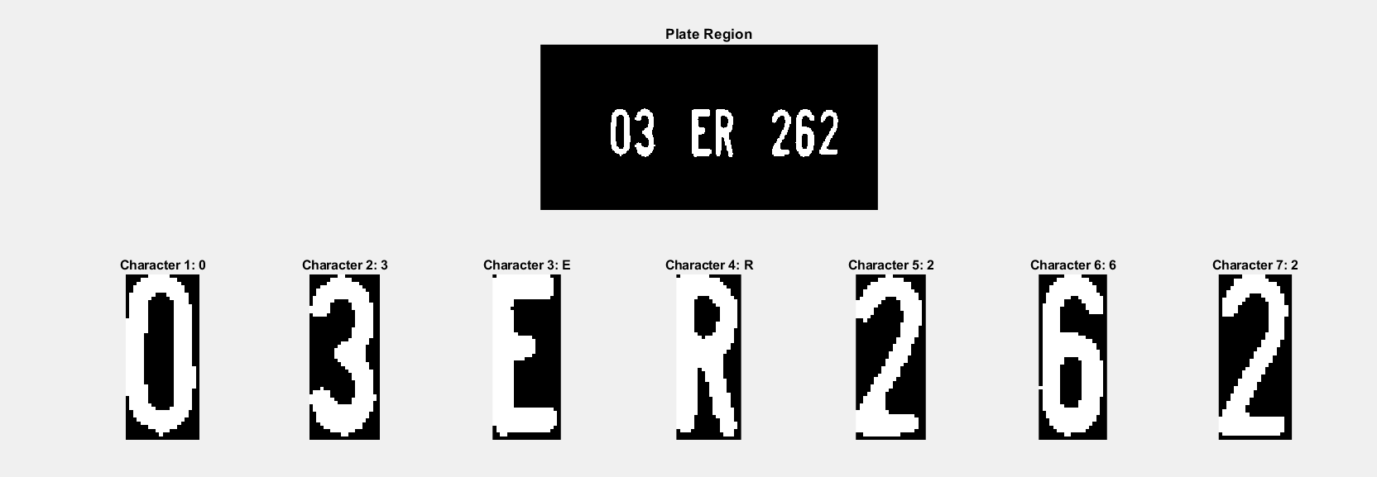
Reading Characters

Slide 10
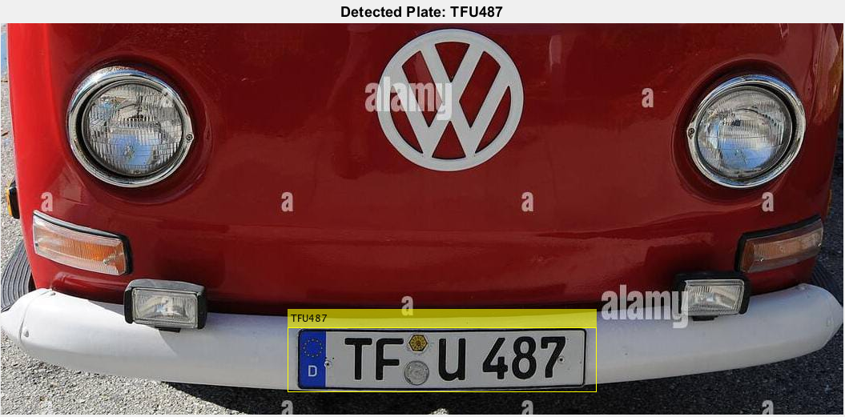
Results & Annotation

Slide 11
Challenges & Limitations
Challenges:
Variable lighting/angles.
Complex backgrounds.
Limitations:
Template matching requires predefined fonts.
Single-plate detection (no multi-plate support).

Slide 12
Thank you!

